Slide 1

CASE-3 Understanding Political Polls
Aman Sharma​
Bhavya Ahuja​​
Maninder Kaur​​
Santhamohan Manivannan​​
Simon Achkar​​
Zewei Yan

Slide 2
What Is A Random Sample? How Would You Go About Collecting One? What Factors Must You Consider When Designing A Sample Frame?
Random sampling refers to a variety of selection techniques in which sample members are selected by chance, but with a known probability of selection.
Most social science, business, and agricultural surveys rely on random sampling techniques for the selection of survey participants or sample units, where the sample units may be persons, establishments, land points, or other units for analysis.
Random sampling is a critical element to the overall survey research design.

Slide 3
What Is A Random Sample? How Would You Go About Collecting One? What Factors Must You Consider When Designing A Sample Frame?
Random Sampling Techniques
Simple random sample: Every member and set of members has an equal chance of being included in the sample. Technology, random number generators, or some other sort of chance process is needed to get a simple random sample.
Example: A teachers puts students' names in a hat and chooses without looking to get a sample of students.
Stratified random sample: The population is first split into groups. The overall sample consists of some members from every group. The members from each group are chosen randomly.
Example: A student council surveys 100 students by getting random samples of 25 freshmen, 25 sophomores, 25 juniors, and 25 seniors.

Slide 4
What Is A Random Sample? How Would You Go About Collecting One? What Factors Must You Consider When Designing A Sample Frame?
Random Sampling Techniques
Cluster Random Sample: The population is first split into groups. The overall sample consists of every member from some of the groups. The groups are selected at random.
Example: An airline company wants to survey its customers one day, so they randomly select 555 flights that day and survey every passenger on those flights.
Systematic Random Sample: Members of the population are put in some order. A starting point is selected at random, and every nth member is selected to be in the sample.
Example: A principal takes an alphabetized list of student names and picks a random starting point. Every 20th, student is selected to take a survey.

Slide 5
What Is A Random Sample? How Would You Go About Collecting One? What Factors Must You Consider When Designing A Sample Frame?
Factors to Consider
Location
Gender
Age
Profession
Ethnicity

Slide 6
The Case Says That 38% Will Vote Liberal. Is This A Fact Or An Estimate?
It Is Only Estimate.
Reason:
Accurate only if the sample is ‘representative’ of the electorate as a whole. (i.e. they are unbiased).
Margin of error = 1.9%. Total survey error needs to be assessed & evaluated.
Again, as it’s sample of population we do not know how many people in Canada will vote Liberals.

Slide 7
The Case Says That The Survey Is Accurate Within 1.9% Points. What Exactly Does This Mean?
Margin of Error
The poll survey reports 38% vote for Liberals & 26% vote for Conservatives.
But the true values would be as high as 39.9%, or as low as 36.1% for Liberals. (i.e., 38% ± 1.9%).
Would fall within the range of 24.1% to 27.9% for Conservatives. (i.e., 26% ± 1.9%)
It’s basically the width of radius of confidence interval.
Smaller Margin of Error = More confident one can be about survey results.

Slide 8
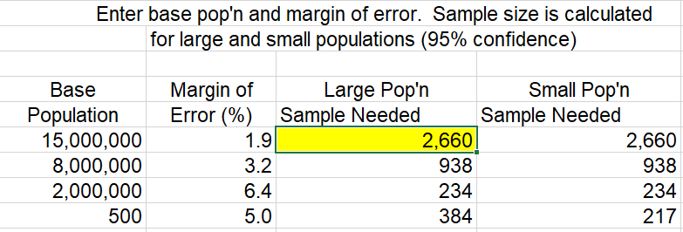
The Case Says That The Sample Consisted Of 2,638 People. Where Did This Number Come From?
2,638 is the total number of individuals who completed the survey.
Sample Size required based on population size in order to construct a 95% confidence interval with margin of error of 1.9% is actually 2,660.
The sample size (n) is calculated according to the formula: n = z² * p * (1 - p) / e² Where: z = 1.96 for a confidence level (α) of 95%, p = proportion (expressed as a decimal), e = margin of error.

Slide 9
The Case Also Says The Results Are Accurate 19 Times Out Of 20. What Does This Mean?
This means that if we were to conduct the same survey 20 times, we would find that the vote for Liberals would fall between 36.1% & 39.9% & the vote for Conservatives would fall between 24.1% & 27.9% in 19 out of the 20 times.
Confidence Interval = 95%
This means that 95% of all samples taken from the same population will have the same margin of error.

Slide 10
The Ontario Poll Has 940 People Whereas The Nation Poll Had 2,638 People. Why This Difference? How Does The Smaller Sample Size Affect The Results? How Can They Still Be Confident The Poll Is Right 19 Times Out Of 20?
Pollsters determined the sample size for constructing 95% confidence interval with the margin of error not exceeding 1.91% for National Poll & 3.2% for Ontario Poll:
The sample size (n) is calculated according to the formula: n = z² * p * (1 - p) / e² Where: z = 1.96 for a confidence level (α) of 95%, p = proportion (expressed as a decimal), e = margin of error.
Using the Formula:
National Poll Sample Size: 2638
Ontario Poll Sample Size: 938

Slide 11
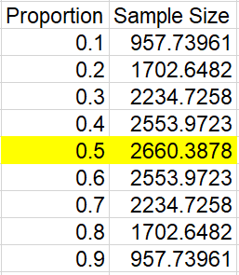
The Ontario Poll Has 940 People Whereas The Nation Poll Had 2,638 People. Why This Difference? How Does The Smaller Sample Size Affect The Results? How Can They Still Be Confident The Poll Is Right 19 Times Out Of 20?

Slide 12
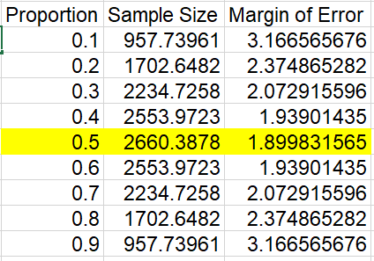
The Ontario Poll Has 940 People Whereas The Nation Poll Had 2,638 People. Why This Difference? How Does The Smaller Sample Size Affect The Results? How Can They Still Be Confident The Poll Is Right 19 Times Out Of 20?

Slide 13
The Ontario Poll Has 940 People Whereas The Nation Poll Had 2,638 People. Why This Difference? How Does The Smaller Sample Size Affect The Results? How Can They Still Be Confident The Poll Is Right 19 Times Out Of 20?
What they are talking about is called a "Confidence Interval."
You can be "95% confident" that the actual percentage in the population—which you could only get by asking everyone—is within the stated number of percentage points of the percentage you got from the sample.
"19 out of 20" is the same as 95%.
A 95% confidence interval is a common precision measure in sample survey research. This confidence interval applies only to Sampling Error.

Slide 14
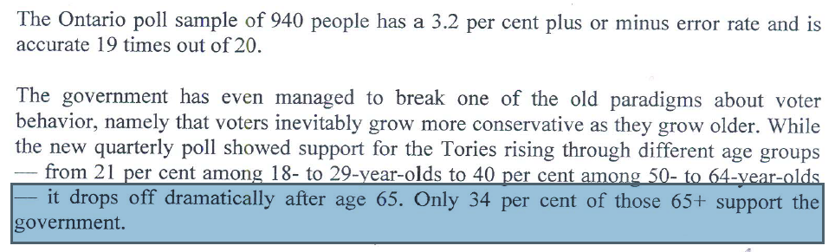
The Journalist Said That Support Drops Off Dramatically After Age 65. Do You Agree With This Statement? If Not, Why Is He Wrong?
Disagree With This Conclusion of the Journalist.
We cannot determine the sample size of each group which can effect the final result.
Margin of error is given to be as 3.2%. So if the true value happens to be 37.2% the drop is not too large.

Slide 15
References
Probabilities: The Little Numbers That Rule Our Lives By Peter Olofsson
https://www.math.lsu.edu/~madden/M1100/week12goals.html
https://www.youtube.com/watch?v=LGFqxJdk20o (How to calculate Samples Size Proportions)

